Slide 1
2. How It Started
After the Democratic Party suffered serious losses in 2004, George Soros convened a meeting of the top liberal strategists and progressive donors to conduct an autopsy of what went wrong, and from that meeting they formed a network of donors who committed to funding leaders and institutions that would last beyond one election cycle. From that meeting they invested in policy shops, watchdog groups and training centers for activists to focus.
The main groups that formed as a result of this meeting were Democracy Alliance and Arabella Advisors who have since pumped billions of dollars behind progressive candidates and organizations through strategic giving impact plans.

Slide 2
ARABELLA ADVISORS
Arabella is a philanthropic consulting company that guides the strategy, advocacy, impact investing, and management for high-dollar left-leaning nonprofits and individuals.
The company was founded in 2005 by Eric Kessler, a Clinton administration alumnus and long-time staffer at the League of Conservation Voters who remains a senior managing partner at the firm.
Arabella Advisors manages four nonprofits that serve as incubators and accelerators for a range of other left-of-center nonprofits. These include the New Venture Fund, the Sixteen Thirty Fund, the Hopewell Fund, and the Windward Fund. Since the network’s inception, Arabella’s four “sister” nonprofits have sponsored roughly 340 such groups targeting a number of different issue areas, including healthcare, net neutrality, abortion access, gun control President Donald Trump’s U.S. Supreme Court confirmations, and others.
Between 2006 – 2019 Arabella’s nonprofit revenues have totaled over $3.1 billion
Between 2008 – 2019 Arabella’s nonprofits paid the company nearly $136 million in contracting and management services fees. Many of Arabella’s top officials, including firm founder Eric Kessler, are principal officers on the nonprofits’ boards of directors.
Arabella has implemented over 300 different “pop-up” projects targeting a range of issues, including net neutrality, free speech, abortion access, Obamacare, and President Donald Trump’s judicial nominees.

Slide 3
ARABELLA CONT…
They support family philanthropists, family foundations, by providing staffing. What that means is, there’s a whole bunch of foundations with assets between about $30 million and $300 million whose address is in the Arabella Office. They are their executive director, their program officer, their grant manager.
They provide strategy analysis for foundations of all types—big, professionally staffed foundations like the Rockefeller Foundation, small family foundations, corporate foundations. They will come to us and say, “We want to transform education in America. We want to eradicate this disease. We want to build great economic opportunity in our community.” And Arabella jumps in and does all the research and analysis. They write a plan, and often those foundations will hire them to manage that for them.
They also have an impact-investing arm where they’re sourcing for-profit investments that align with their clients’ interests. So for a client that cares about education reform, they find investment opportunities in education technology companies. And they manage collaboratives among funders. So if five funders want to come together and jointly address sustainable energy in America and policies that affect that, they manage a group of funders to work together and facilitate their work.

Slide 4
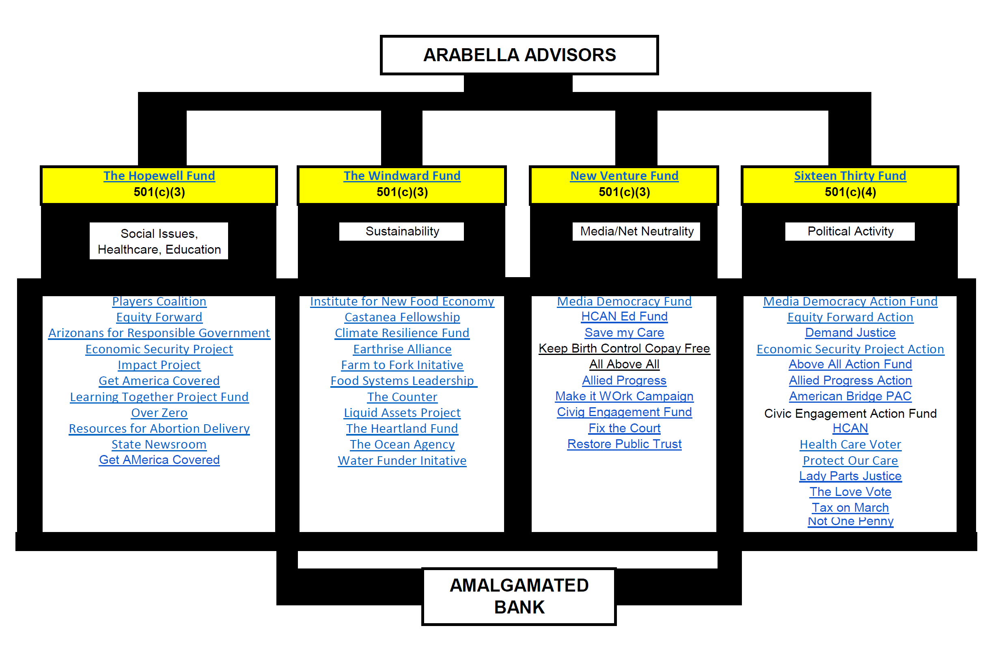

Slide 5
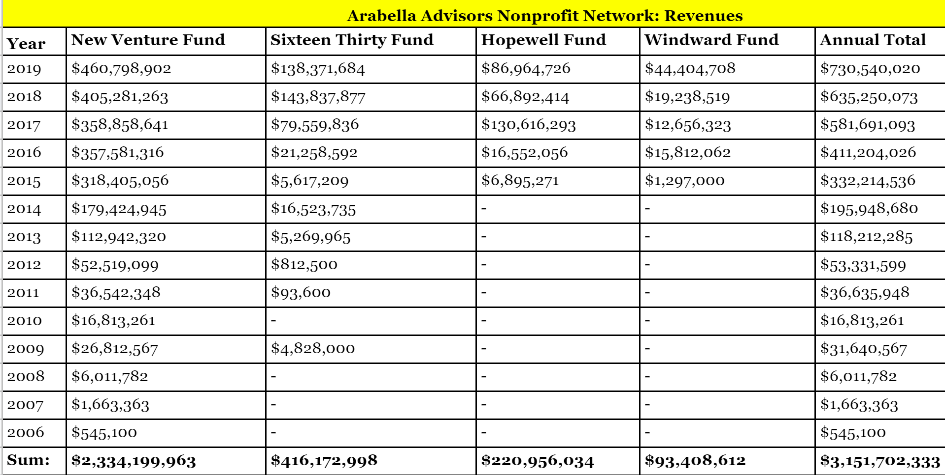

Slide 6
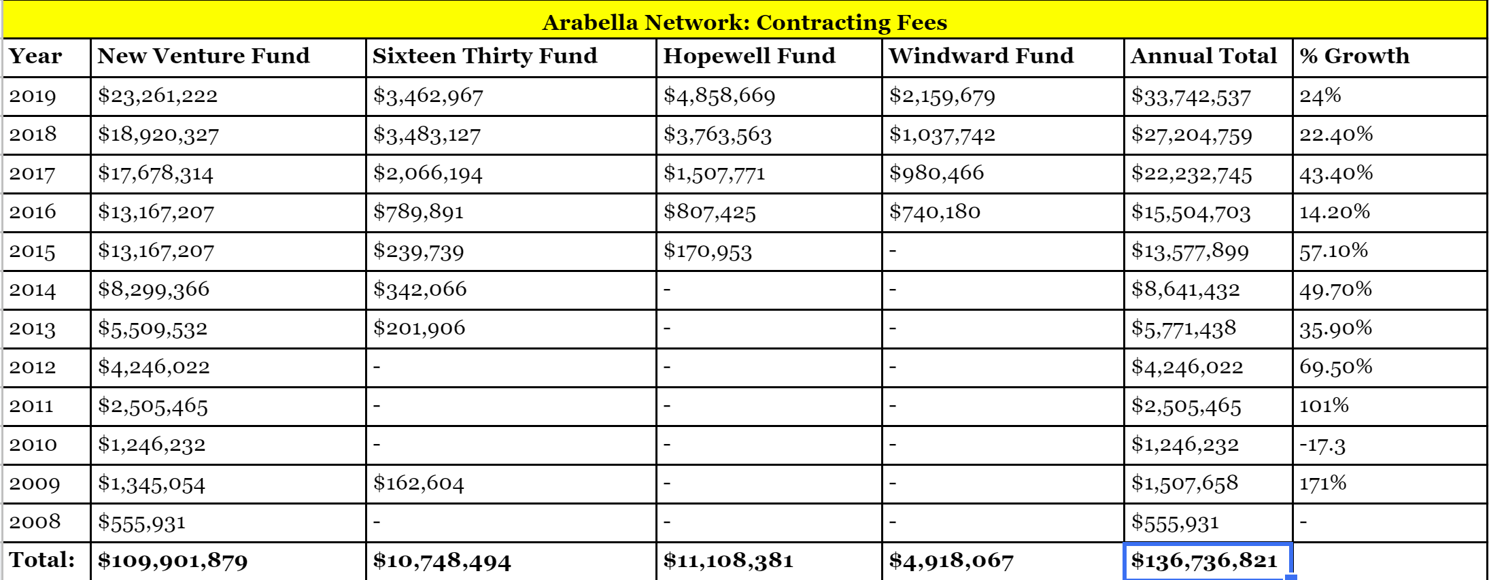

Slide 7
The Hopewell Fund
The Hopewell Fund is a 501(c)(3) nonprofit created in 2015 that primarily sponsors activist groups focused on abortion access and other social issues.
In 2019, the Hopewell Fund reported revenues of $86 million

Slide 8
The Windward Fund
The Windward Fund is a 501(c)(3) nonprofit formed in 2015 that primarily sponsors environmentalist groups.
The Windward Fund focuses on environmentalist causes, thanks to funding that includes multi-million dollar grants from the Rockefeller, Kellogg, and Walton (of Wal-Mart fame) Foundations.

Slide 9
The New Venture Fund and Sixteen Thirty Fund
The real stars of the Arabella network are the New Venture Fund and the Sixteen Thirty Fund.
The pair regularly work hand-in-hand to maximize the effectiveness of their “pop-up” campaigns.
This tends to take the form of a New Venture-sponsored fundraising arm and a Sixteen Thirty-sponsored advocacy and lobbying arm.
Under this model, these “pop-up” projects take full advantage of the two Fund’s different tax statuses.
The fundraising arm, for instance, offers donors tax-deductibility on their donations, thanks to the New Venture Fund’s 501(c)(3) designation, and that same status also makes it easier for multi-billion-dollar foundations to contribute, while hiding what particular project they’re supporting. The advocacy arm, on the other hand, is allowed far greater lobbying limits by the IRS under the Sixteen Thirty Fund’s 501(c)(4) designation.

Slide 10
New Venture Fund
The New Venture Fund is a 501(c)(3) nonprofit and the oldest of Arabella Advisors’ four nonprofits, originally created in 2006 as the “Arabella Legacy Fund.” The New Venture Fund is the largest of Arabella’s nonprofits by revenues, expenditures, and number of activist groups it’s sponsored; as such, it’s been described as the “flagship” of Arabella’s nonprofit network.
The New Venture Fund claims it has sponsored over 280 projects across a range of left-of-center issues. In 2018, NVF reported $405.3 million in revenues.

Slide 11
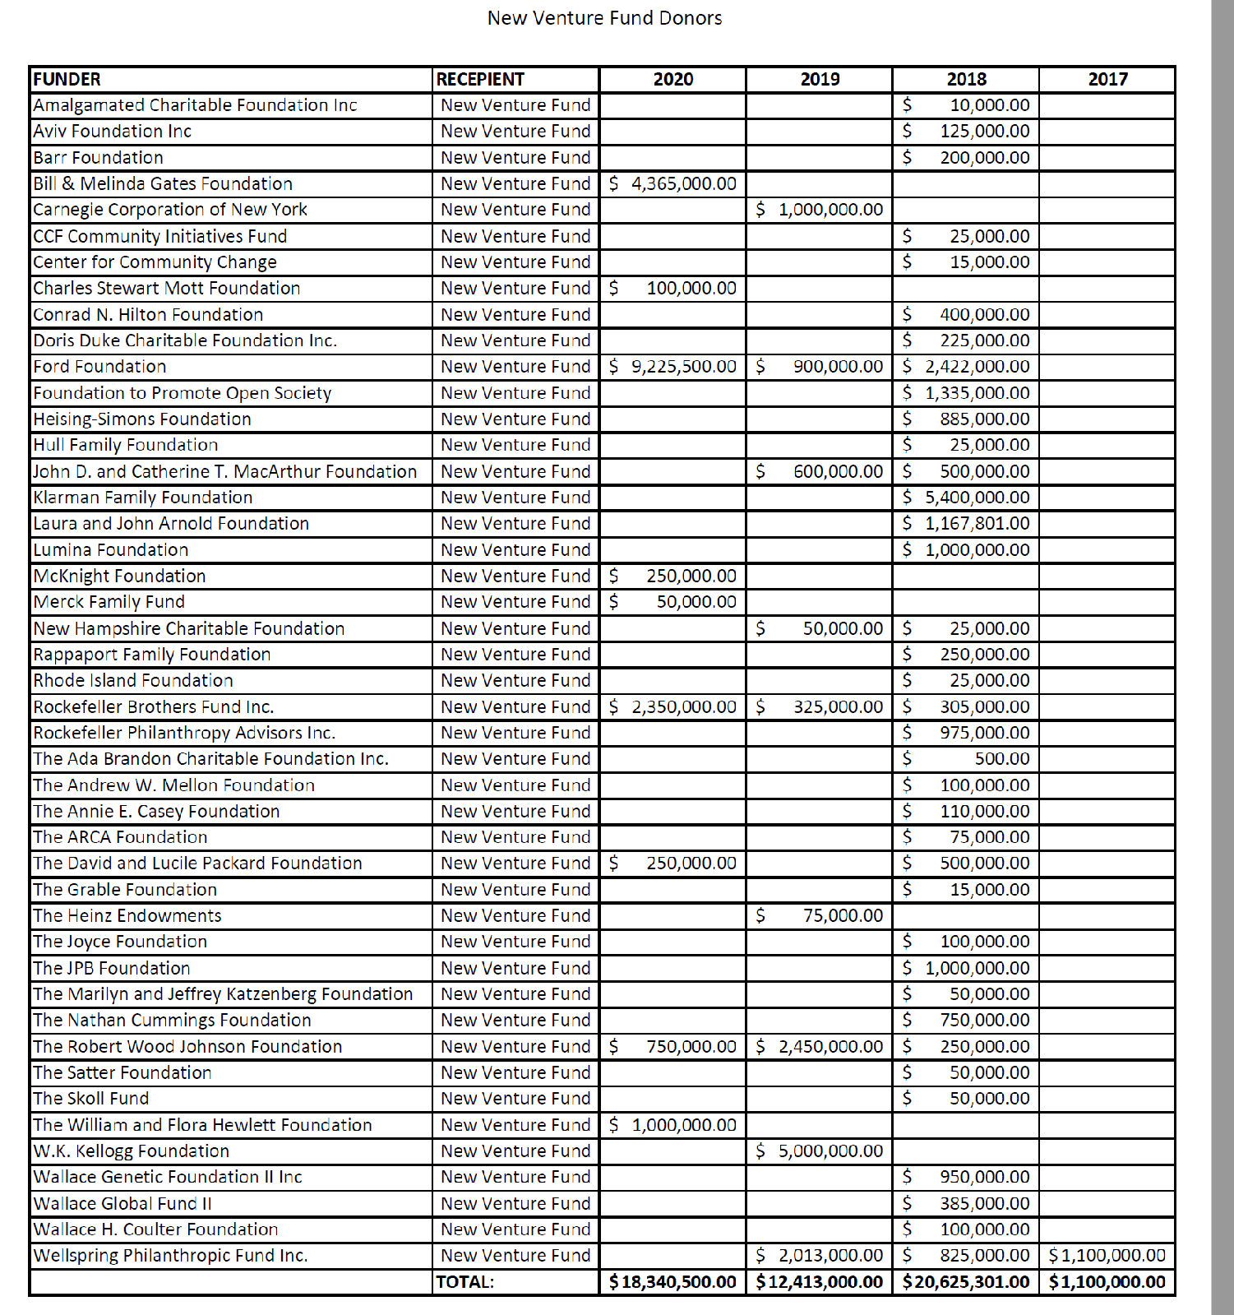

Slide 12
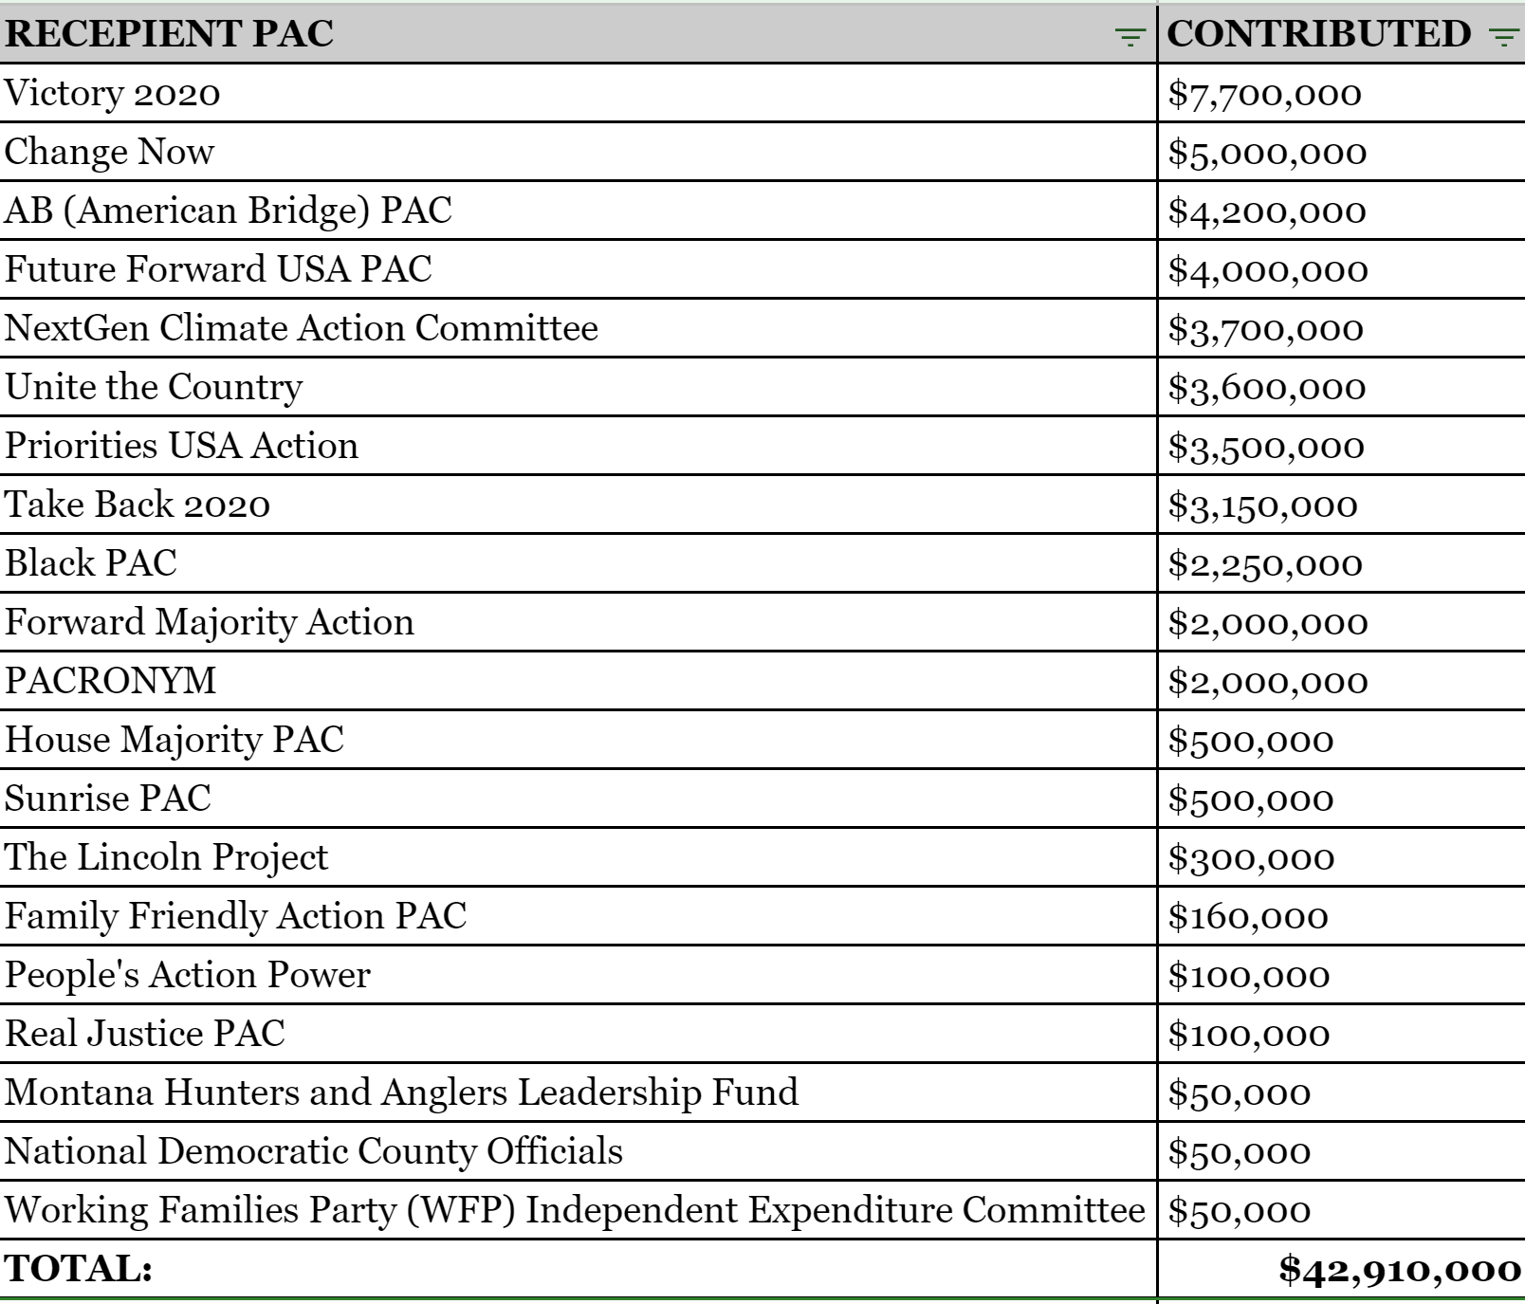
Sixteen Thirty Fund 2020 Donations
The Sixteen Thirty Fund is Arabella’s sole 501(c)(4) advocacy nonprofit and the second-oldest of its nonprofits, created in 2009. The Sixteen Thirty Fund sponsors lobbyist groups such as the judicial advocacy group Demand Justice, and engages in political advocacy, including independent expenditures targeting Republican politicians during elections. They are doing about $150 million a year in revenue.

Slide 13
Sixteen Thirty Fund – 501 (c)(4)
In its 2016 investment portfolio report, the Democracy Alliance—a network of highly influential donors who coordinate funding to left-wing groups—revealed that it has run at least eight of its funding streams through the New Venture Fund and Sixteen Thirty Fund, even instructing donors that 501(c)(3) and 501(c)(4) checks “must be written payable to” each respective Arabella-run Fund. The document illustrates how Arabella’s Funds manage pair projects, each of which features both a (c)(3) fundraising and (c)(4) “action” arm. Similarly, after President Trump successfully passed a Republican tax reform bill in 2017 and ended Obamacare’s individual mandate to buy health insurance, left-wing protesters rushed to save the dying healthcare bill, creating groups designed to look like grassroots organizations.35
At a glance, these groups—such as Save My Care and Protect Our Care—appeared to be impassioned examples of citizen activists defending Obamacare. In reality, neither “not-for-profit” advocacy group appears to have paid staff, held board meetings, or even owned so much as a pen.
In fact, they never filed anything publicly revealed, because they aren’t independent nonprofits—they’re just projects of the New Venture Fund and Sixteen Thirty Fund, respectively, run by professional consultants and working in tandem to outmaneuver Republicans and organizations that oppose the Affordable Care Act.

Slide 14
Because these groups can pop up at the speed it takes to publish a website, they tend to be run as short-term, high-intensity media campaigns targeting the news cycle. This was perhaps most obvious during the Left’s effort to derail the confirmation of Supreme Court Justice Brett Kavanaugh in October 2018, when a crowd of activists—led by a newly “popped-up” group called Demand Justice—waved glossy pre-printed signs that read “Stop Kavanaugh.” At a glance, Demand Justice was an activist group like any other. But closer inspection of its website showed that the group was really a front for the Sixteen Thirty Fund.
Supplementing Sixteen Thirty Fund-backed lobbying groups are “sister” groups created by the New Venture Fund. The ironically named Fix the Court, for instance, could be considered Demand Justice’s unofficial research arm, though the two groups don’t advertise that they are tied to each other through Arabella Advisors. But when asked during a 2016 C-SPAN interview how much of his group’s money comes from the New Venture Fund, Fix the Court’s executive director Gabe Roth said, “All of it.”41
Both Demand Justice and Fix the Court ran parallel campaigns attacking Trump judicial nominees Thomas Farr and Brett Kavanaugh. Perhaps nothing better illustrates the fake “grassroots” activism at play against the nominees than when Demand Justice cited Fix the Court as “a nonpartisan watchdog group” in its FOIA (Freedom of Information Act) request that demanded over 1 million pages of documents from Kavanaugh’s prior government service.42
While the Sixteen Thirty Fund’s projects are generally created to lobby loudly, the New Venture Fund’s projects often take a subtler approach to advocacy. In December 2018, the Wall Street Journal’s Kim Strassel reported on the so-called “Ethics Resistance” barraging President Trump with FOIA requests and lawsuits intended to encumber his administration, if not set him up for impeachment.43

Slide 15
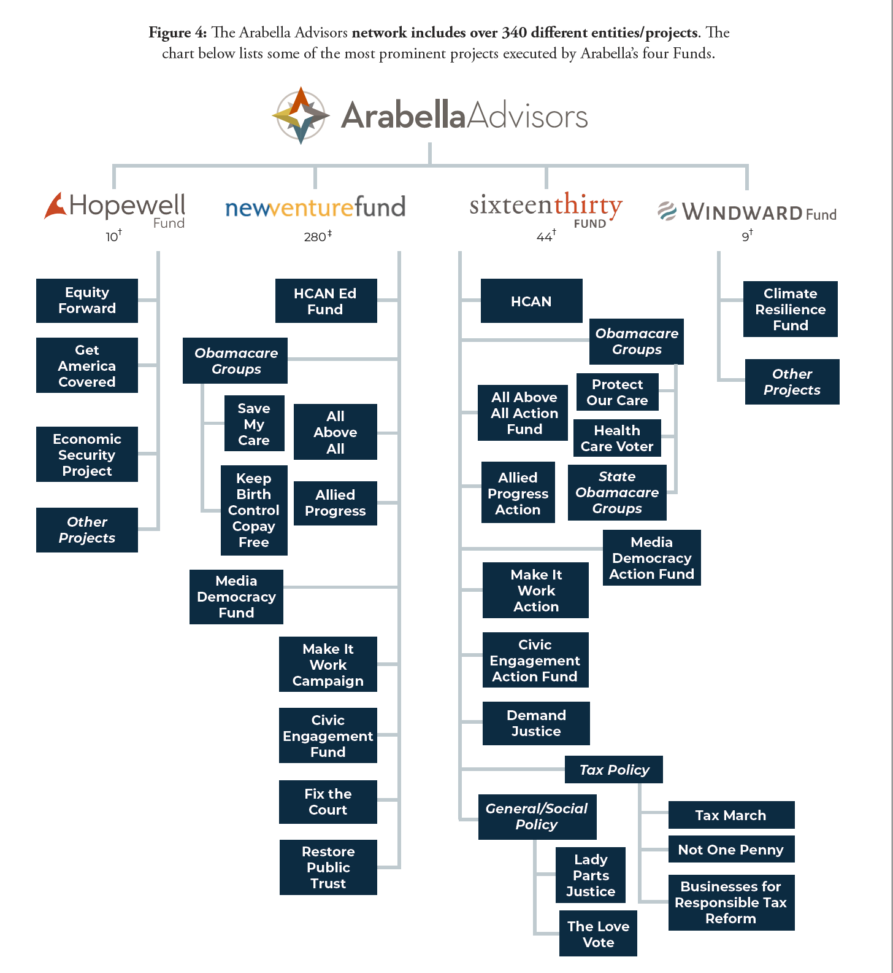

Slide 16
Media - Institute for Nonprofit News
Coaltion Members | Center for Investigative Reporting (Non-profit)
Coaltion Members | Center for Public Integrity (Non-profit)
Coaltion Members | Center for Responsive Politics (Non-profit)
Coaltion Members | Center for Rural Strategies (Non-profit)
Coaltion Members | Colorado Independent (Non-profit)
Coaltion Members | First Look Media (Non-profit)
Coaltion Members | Grist Magazine (Non-profit)
Coaltion Members | InsideClimate News (Non-profit)
Coaltion Members | In These Times (Non-profit)
Coaltion Members | International Consortium of Investigative Journalists (ICIJ) (Non-profit)
Coaltion Members | Mother Jones (Non-profit)
Coaltion Members | National Institute on Money in State Politics (Non-profit)
Coaltion Members | Next City (For-profit)
Coaltion Members | ProPublica (Non-profit)
Coaltion Members | Pulitzer Center on Crisis Reporting (Non-profit)
Coaltion Members | The Trace (Non-profit)
Donor Organizations | Craigslist Charitable Fund (Non-profit)
Donor Organizations | Democracy Fund (Non-profit)
Donor Organizations | Foundation to Promote Open Society (FPOS) (Non-profit)
Donor Organizations | John D. and Catherine T. MacArthur Foundation (Non-profit)
Donor Organizations | John S. and James L. Knight Foundation (Non-profit)
Donor Organizations | Joyce Foundation (Non-profit)
Donor Organizations | National Endowment for Democracy (Non-profit)
Donor Organizations | NEO Philanthropy (Non-profit)
Donor Organizations | Peace and Security Funders Group (PSFG) (Non-profit)
Donor Organizations | Robert R. McCormick Foundation (Non-profit)
Donor Organizations | Rockefeller Brothers Fund (Non-profit)
Donor Organizations | Silicon Valley Community Foundation (Non-profit)
Donor Organizations | Spectemur Agendo (Non-profit)
Donor Organizations | Wellspring Philanthropic Fund (Non-profit)

Slide 17
AMALGAMATED BANK
Amalgamated Bank of New York (known as Amalgamated Bank) is the nation’s largest labor union-owned bank. Created originally by the Amalgamated Clothing Workers of America (ACWA), since 2010 the bank have been controlled by the Service Employees International Union’s (SEIU) Workers United division. It has over $4 billion in assets and nearly $40 billion under management, largely from union pension funds.
The bank operates as a “a left-of-center, changemaker bank” that uses financial mechanisms to push for liberal corporate policies and provides boutique banking services to labor unions, left-of-center organizations, environmentalist-aligned businesses, and liberal candidates. The bank counts Ready For Hillary (Hillary Clinton’s super PAC) the Democratic National Committee, and hundreds of labor unions and liberal organizations as its clients.^{[4]} The bank offers these liberal clients tailored products that help them to carry out their liberal mission, including a 24-hour concierge for liberal political candidates, and a new product that helps unions automatically collect member fees if state legislatures restrict the union’s ability to mandate this collection.
The bank also uses its considerable financial resources to pursue a left-wing corporate governance agenda. Through activist investing, the bank only invests its in companies that share its liberal social and environmental goals. Amalgamated seeks to force corporate boards to implement left-of-center policies, including environmentalist policies, political spending disclosures, and labor restrictions.
Additionally, the bank uses its internal policies to act as a standard bearer for left-wing corporate policies such as the $15/hour minimum wage] and union purchasing preferences.

Slide 18
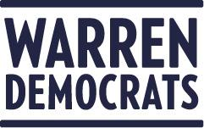
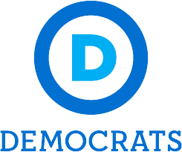
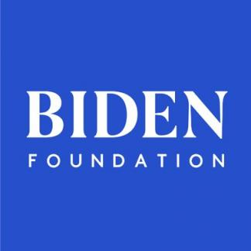
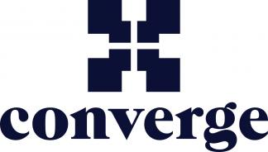
AMALGAMATED CLIENTS

Slide 19
FOUNDATION SPENDING ON NON-PROFIT ORGANIZATIONS INVOLVED IN U.S. ELECTORAL POLICY

Slide 20
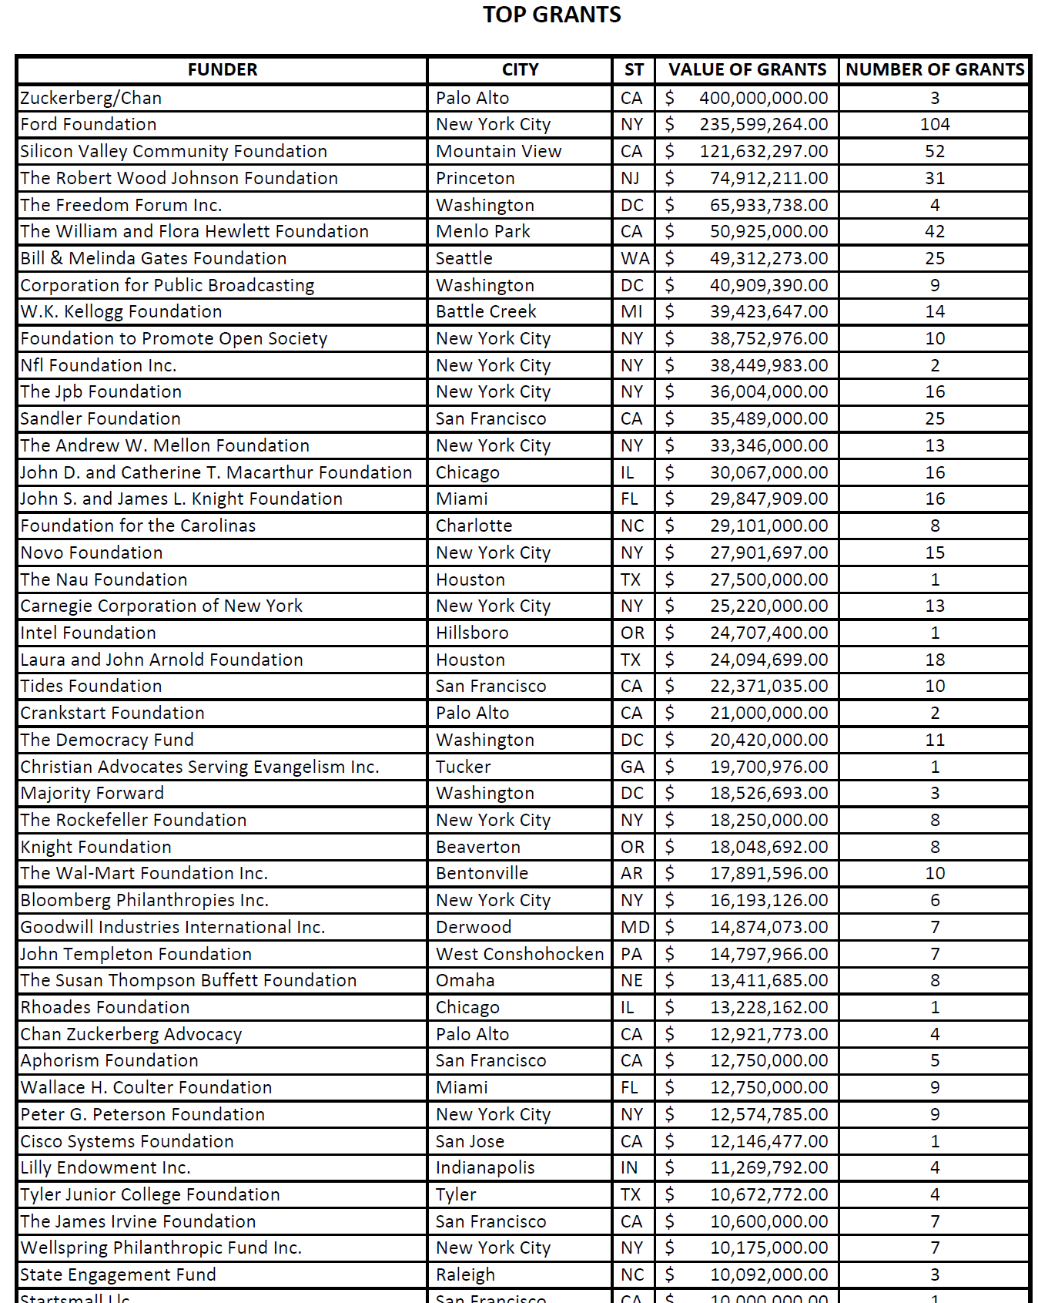

Slide 21
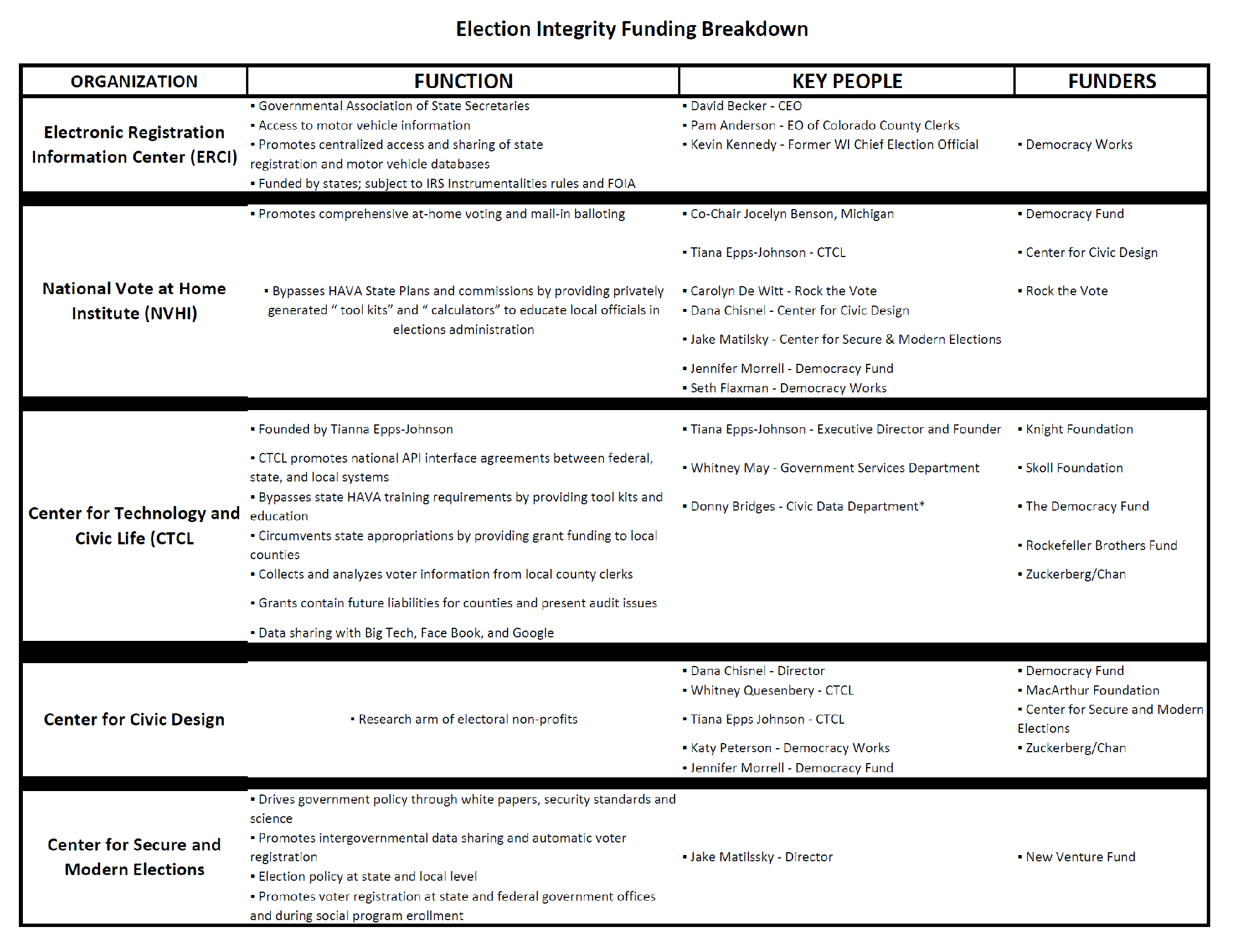

Slide 22
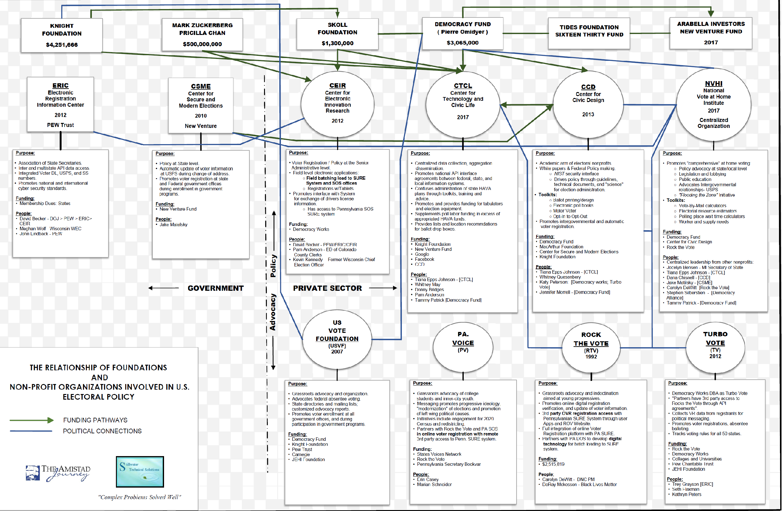
FOUNDATION FUNDING

Slide 23
DONOR ADVISED FUND
A donor-advised fund is like a charitable investment account, for the sole purpose of supporting charitable organizations you care about. When you contribute cash, securities or other assets to a donor-advised fund at a public charity, like Fidelity Charitable, you are generally eligible to take an immediate tax deduction. Then those funds can be invested for tax-free growth and you can recommend grants to virtually any IRS-qualified public charity.

Slide 24
Muneer Satter
“Muneer Satter, a retired partner at Goldman Sachs who now manages a medical device investment fund as well as his family office, is a philanthropist who believes in results-focused grant making and doesn’t mind taking a risk here and there to maximize his impact. Through his family foundation, he and his wife, Kristen Hertel, invest in strong leaders tackling challenges like human rights abuses, poverty, educational disparities, disease and environmental issues. For example, Muneer established a first-of-its-kind fellowship for Harvard Law School students and recent graduates that responds to mass atrocities and human rights abuses around the world, while also creating a pipeline of human rights lawyers.”
satterfoundation.com

